Slide 1
Accounts Payable Best Practices
Michael Casuccio, ITS
Michelle McGinty, Kennesaw State University

Slide 2
Agenda
Best Business Practices
Approvals
Internal Controls
Invoices
Stipends
Petty Cash
Vendors

Slide 3
Agenda
GeorgiaFIRST Financials – PeopleSoft
Vendor settings
Invoices and Voucher processing
Payments and Paycycles

Slide 4
Approvals
Accountability, Authorization and Approval
Department Table is used to determine who has authority to approve expenditures for the department.
Project Table is used to determine who has authority to approve expenditures for the project.
Other approvals include:
ITS for computer purchases
Asset Management
Audio Visual Equipment
Hazardous Materials
Human Resources (on-payroll, qualified Independent Contractor status)

Slide 5
Controls in Place?
The Controller approves payments over $5,000 and payments to individuals.
Consultant, Lecturer (Speaker) and Performance Agreements have standard templates which are approved by Legal. The routing form allows all departments to view the agreements before they are paid.

Slide 6
Other Controls
Employees are never paid as a consultant, speaker or for services through AP. This must be reviewed by HR and the payment must go through Payroll.
Anyone, who was on payroll, needs to be paid consistently on payroll. This includes student assistants who are paid a stipend for additional work on campus.

Slide 7
Stipends/Sponsored Funds
Stipends should include timesheets for dates worked.
Consultant or Contractors on Sponsored Fund agreements must include a statement of work and resume of the consultant/contractor.
Stipends for work performed are taxable.

Slide 8
Valid Invoice?
Best Practice: valid invoice (not a quote)
Duplicate Invoice Checking
Set up Financial/Supply Chain
Business Unit Related
Payable/Payable Options
Vouchering Options 2 – Duplicate Invoice Checking
Invoice Number, Business Unit, Vendor ID

Slide 9
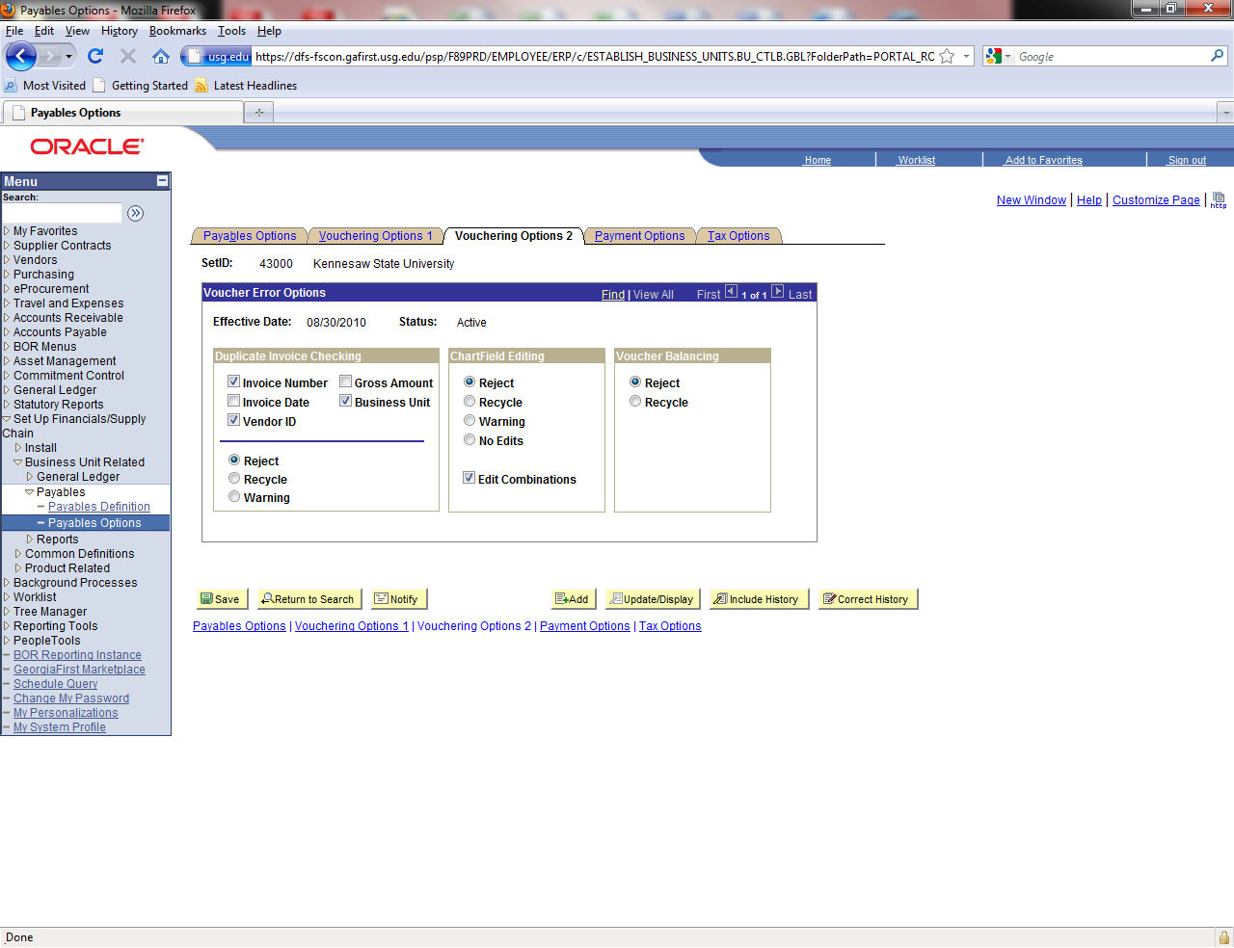

Slide 10
No Invoice Number?
Establish procedures for recording invoice numbers.
No invoice number?
Identify a method that will allow the ERP system to capture duplicate payments.
Travel: first day of travel + letter for multiples MMDDYY or MMDDYYA or MMDDYY-1
Utility/Cell Phone Invoices: account number + date
Service Contracts: date of service MMDDYY.

Slide 11
Where Do Your Invoices Go?
Best practice: have all invoices directed to Accounts Payable.
Purchase Order should specify remit address for invoices.
Statements should come to Accounts Payable to verify there are no outstanding invoices.

Slide 12
Petty Cash
No Student payments from petty cash.
No independent contractor for services.
Receipts must be attached.
Sales Tax is not reimbursed.
Flyers and list of attendees are required.
Compliance with food policy.

Slide 13
Vendor Maintenance
Separation of Duties. The employee who maintains the vendor files should not be able to process vouchers or issue purchase orders.
W-9 should be required.
Only one vendor per W-9/FEI number. Use remit to address to handle different payment addresses.

Slide 14
Vendor – Legal Status
Corporate Vendors: Verify legal status at: http://www.coordinatedlegal.com/SecretaryOfState.html
If status is Active/Compliant or Active/Noncompliant - continue processing
If Admin. Dissolved, follow up with campus contact.

Slide 15
International Vendors
W-9 - applies to US Citizens/Permanent Resident only.
W8BEN and Foreign National Information Form with copies of requested immigration documents.
KSU uses the name “*****” five stars in the name2 field on the vendor master page.
Query: 430_AP_VERIFY_INTL_VENDOR

Slide 16
Vendor Location
From PeopleBooks:
It is Not a physical address.
It is a default set of rules, or attributes.
Defines how you conduct business with a particular vendor.
There can be multiple ‘locations’ for each vendor.

Slide 17
Peoplesoft Vendor Options
Vendor/Location/Options “Payables”
Payment Control
Matching/Approval Options
EFT Options
Fund Transfer Details
Vendor Banking Account Options
Vendor Type Options – EMP for Employee?
Location Main? Your remit to address?
Notes:
Discuss what a vendor ‘location’ is.

Slide 18
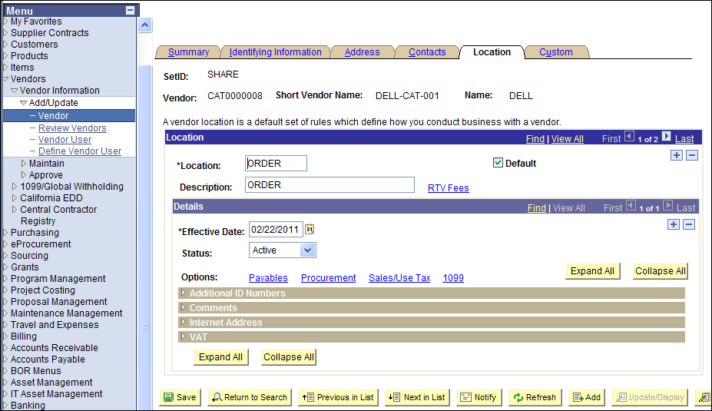

Slide 19
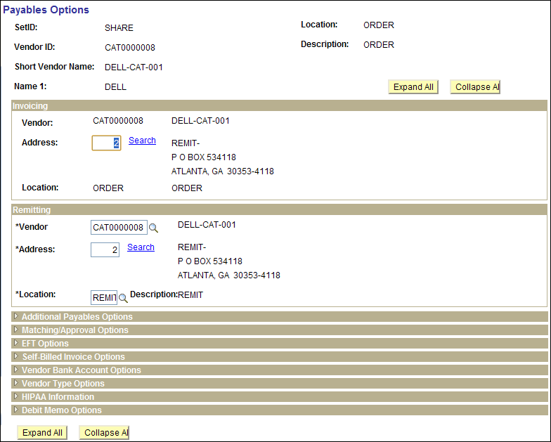

Slide 20
Payables Default Hierarchy
Business Unit
Origin
Control Group
Vendor
Voucher
Notes:
Keep this heirarchy in mind when setting values for the vendor.
Next slide shows an example.

Slide 21
Peoplesoft Vendor – Cont.
Identifying Information
Duplicate Invoice Indicator. KSU uses “Default”
Withholding Vendor?
Persistence
Regular
One Time – Only one payment is generated and then the system will “I” inactivate the vendor ID. Good for International Vendors and one-time payments.
Single Pay – Good for refunds where AP has the control to add the vendor’s address/name. Strong Internal Controls should be used with this option. No 1099 reportable payments.
Contacts
Description ACH/EFT.. Use Email ID for Remit to information.

Slide 22
1099 Reportable
1099 reportable activity accounts:
7278%, 719xxx, 7481xx, 751xxx
Royalties
Rental of Non-Real Estate
Real Estate Rental
Per Diem & Fees – Expense (not reimbursed expenses)
Architect, Attorney, Consultant, Engineer, Physician, Interpreters, Veterinarian, Speaker, IT Consultant,
752100 for Reimbursed Expenses to Consultants should be used or Non-Employee expense account 65XXXX.
International Vendors 1042s

Slide 23
Internal Control Practices
Separation of Duties (should not be performed by Accounts Payable)
Approve purchase (Budget Manager)
Receive ordered materials
Approve invoice for payment
Review and reconcile financial records. This means that the person who can print the check should not be the one reconciling the bank account.

Slide 24
Match receipts to Invoices
All PO invoices must have some sort of receiving notification.
This may be as simple as an email from the end user who says the product was received.
Issue Payment/Check Request is based on an assumption that the product was received by the end user.
Notes:
All invoices associated with a purchase order must have some sort of receiving notification in order to process.
This may be as simple as an email from the end user who says the product was received.
Issue Payment/Check Request is based on an assumption that the product was received by the end user.

Slide 25
Automatic Three Way Matching
Purchase Order must be set to Receiving Required.
Match the invoice by copying in the purchase order.
Match exceptions will occur when there is no open receiver for the purchaser order.
Assets must be copied in from a receipt.
Notes:
ITS Mod to require Asset from Receipt.

Slide 26
Matching Process
Setting | Matching
PO: Do Not Receive or Optional | 2-way matching Compares voucher to PO
PO: Receiving Required | 3-way matching Compares voucher - PO - Receipt

Slide 27
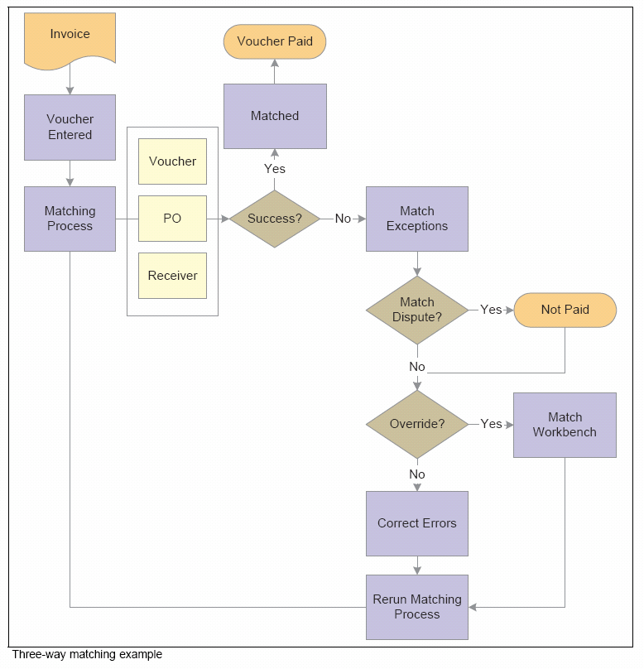
Notes:
Document Association

Slide 28
Matching Exceptions
PeopleBooks Note:
Organizations typically correct a problem instead of overriding it. In general, it is best to rectify and reprocess incorrect associations and vendor differences rather than override them.
Notes:
Document Association

Slide 29
Match Exceptions
Query to identify Match Exceptions
BOR_AP_UNPOSTED_VCHR
Matching Workbench
What are common Match Exceptions
Missing Receiving
PO set at “Receiving Required” in error.
Receiving not equal to PO amount/Qty.

Slide 30
Document Tolerance
Allowable difference between a PO and Voucher
Percentage or Amount
Default setting by business unit
The lesser of $500 or 10%
Can be changed on the PO distrib lines
Notes:
Is this the lesser of one or the other?
State purchasing guidelines if more than this than the PO should be changed.

Slide 31
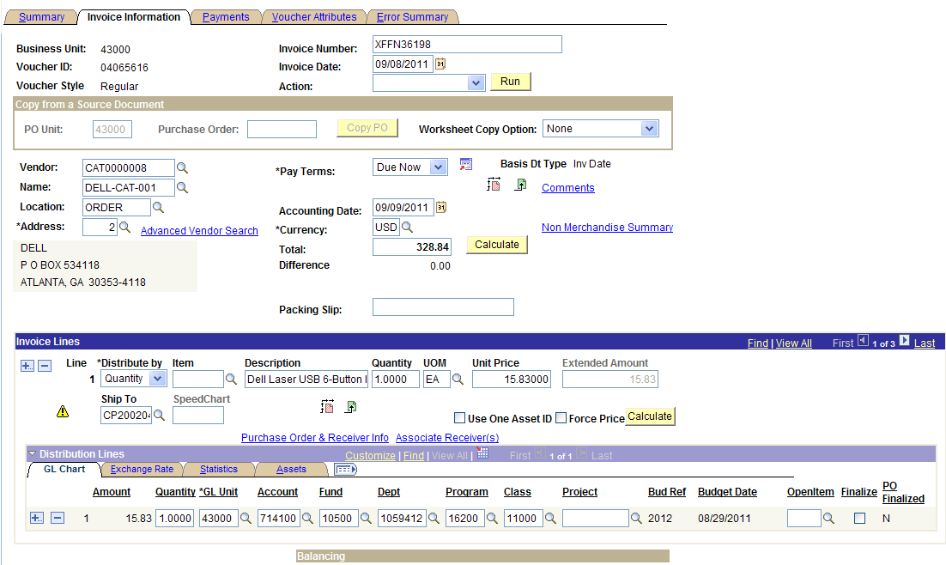
To Finalize or Not
Notes:
Finalize hyperlinks are only available if the accounting date is in a current open period.

Slide 32
To Finalize or Not
What does it do?
Finalizes the predecessor PO line
Final liquidation of the KK distribution line
Advantages:
Eliminates the need to run PO reconciliation process to determine the closing of a PO or PO line
Quickly frees up funds.

Slide 33
To Finalize or Not
When to use it:
Vouchering the last invoice for a PO or PO line but the amount or quantity is less than the original
When not to use it:
If you are fully vouchering a PO or PO line
PO Close process will finalize the PO or PO line

Slide 34
To Finalize or Not
Example:
* Not necessary if you run PO close.
PO | Prior Invoices | Final Invoice | Finalize ?
$100 | $0 | $90 | Yes
$100 |  | $100 | No*
$100 | $80 | $20 | No*
Notes:
Maybe drop this.

Slide 35
Distribution Lines
PO vs Voucher
Changes:
Do NOT Change PO lines that that have been vouchered.
Changing Distribution lines
If receipts exits, the receipt must be changed, too.
Notes:
Example: PO for 1 year service contract invoiced monthly
Questions? Discussion?

Slide 36
Voucher Post
Can not post vouchers
Verify Control Group settings
Verify Voucher Attributes Tab on the voucher

Slide 37
Voucher Upload Process
Voucher Upload Spreadsheet
Large volume, low dollar payments to multiple vendors.
One-to-one distributions such as stipends, board checks or UPS.

Slide 38
Payment Method
Payment Method linked with Banking Information and Pay Cycles.
MAN - Manual payments keyed such as wires, direct debits from the bank are keyed using the “Manual” payment process.
ACH (Commercial / Business)
EFT (Personal)
CHK
Notes:
Best practice: Wire transfers should go through AP… audit finding

Slide 39
ACH / EFT
New to ACH/EFT?
Contact ITS for instructions to get started
See Job Aid: RUNNING EFT/ACH PAY CYCLES
Payment Advices

Slide 40
ACH / EFT
PRENOTING
What is it?
Changing the default # of wait days
Run an ACH / EFT pay cycle to trigger the prenotes
Or Manually Confirm
Notes:
Add some ACH/ EFT information.

Slide 41
Pay Cycle Monitoring
Trial Register
Vendor Name/Address matches invoice.
Dollar amount matches invoice.
Invoice number keyed correctly.
Trial Register verified to Detailed Check Register
Performed by individual who does not have vouchering/payment security (outside AP area).
Notes:
Internal Controls

Slide 42
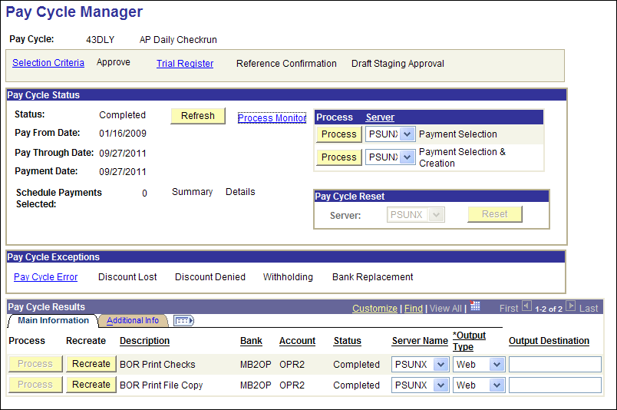
Check the Pay Cycle Exceptions

Slide 43
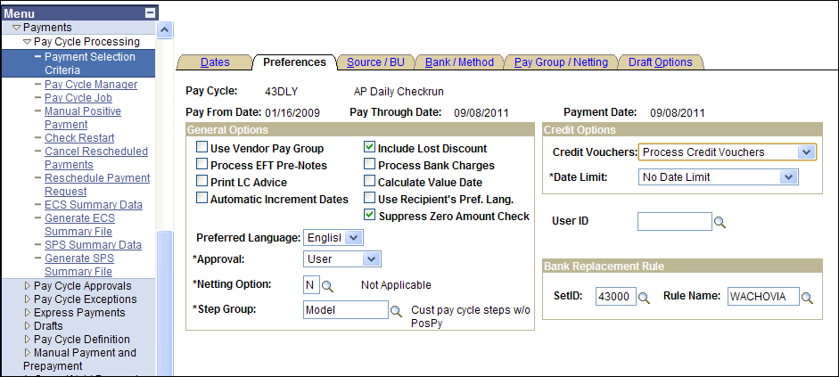

Slide 44
Payment Selection Criteria
Credit Vouchers
Example: voucher $80 and credit vchr $100
Option: Process When DRs >= CRs
Nothing happens because debits are not greater than credits
Option: Process Credit Vouchers
Voucher paid / zero $ payment row / accounting entries
Credit / payment row $80 / remaining $20

Slide 45
Positive Payment
Notifies bank of checks that will be presented for payment.
Contact ITS for assistance in getting started
Review Wimba presentation.
Notes:
How many of you are using this?

Slide 46
Positive Payment
Note the pay cycle ID you are using: POSPY1-9
Verify that you POSPY# runs to completion
Notes:
How many of you are using this?

Slide 47
Positive Payment
GeorgiaFIRST Training Archives
Wimba Session: Using Positive Payment, August 31 2010
Archive: http://gbor.wimba.com/launcher.cgi?room=PSFIN_TRNG_2010_0831_1430_53
Slides and Handout

Slide 48
Month End Close
Run Query: BOR_AP_UNPOSTED_VCHR
Run Query: BOR_AP_UNPOSTED_PYMNTS
Reconciling the Open Payables to the General Ledger.
Aging Payables Report vs. 211000 GL Account
Reconciling Items
Match Exceptions
Un-posted Voucher
Budget Exceptions
Notes:
Maybe mention the month end checklist.

Slide 49
Training Resource
GeorgiaFIRST Training Archives
http://www.usg.edu/gafirst-fin/training/archives/
Wimba Session: Using the PO Workbench and Monthly PO Cleanup Processes, March 23 2010
Archive: http://67.202.210.69/launcher.cgi?room=PSFIN_TRNG_2010_0323_1430_53
Slides and Handouts

Slide 50
Training Resource
GeorgiaFIRST Training Archives
http://www.usg.edu/gafirst-fin/training/archives/
Wimba Session: Using Positive Payment, August 31 2010
Archive: http://gbor.wimba.com/launcher.cgi?room=PSFIN_TRNG_2010_0831_1430_53
Slides and Handout

Slide 51
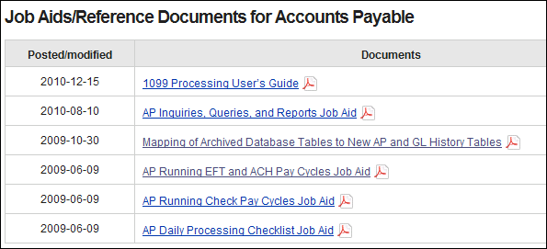
Documentation
http://www.usg.edu/gafirst-fin/documentation/job_aids/category/accounts_payable/

